Slide 1
Exceptions and
IO Streams
Reference: http://chortle.ccsu.edu/java5/cs151java.html

Slide 2
Exceptions
Java Exceptions enable a program to recover from errors and keeps running
Exception is a problem that occurs when a program is running, e.g. ArrayOutOfBoundException, InputMismatchException

Slide 3
What Happens When an Exception Occur?
The Java virtual machine creates (and “throws”) an object of class Exception which holds information about the problem
A Java program may catch the exception
The program can then use the Exception object to recover from the problem

Slide 4
Must a Program Catch Exception?
No. Assume “Hello” is the input of the following code:
Scanner scan = new Scanner( System.in );
int num;
System.out.print("Enter an integer: ");
num = scan.nextInt();
nextInt() throws a InputMismatchException object
Without explicit handling of the exception, the program throws the exception to the Java virtual machine
The Java virtual machine catches the exception, stops the program and prints of trace of the problem

Slide 5
How to Catch an Exception?
Put code that might throw an exception inside a try{} block
Put code that handles the exception inside a catch{} block
Scanner scan = new Scanner( System.in );
int num;
System.out.print("Enter an integer: ");
try {
num = scan.nextInt();
} catch ( InputMismatchException ex ) {
System.out.println("You entered bad data." ); System.out.println("Run the program again." );
}

Slide 6
Syntax Rules for try and catch
The statements in the try{} block can include:
  Statements that always work
  Statements that might throw an exception of one type or another
There can be zero, one or several catch{} blocks following the try{} block
Each catch{} block describes the type of exception it handles

Slide 7
How try and catch work?
When an exception is thrown by a statement in the try{} block, the catch{} blocks are examined one-by-one starting with the first.
The first catch{} block to match the type of the exception gets control
Only one catch{} blocks gets control
If no catch{} block matches the exception, none is picked, and execution leaves this method

Slide 8
How try and catch work?
The most specific exception types should appear first in the structure, followed by the more general exception types
The statements in the chosen catch{} block execute sequentially. After the last statements executes, control goes to the first statement that follows the try/catch structure
Control does not return to the try block

Slide 9
User-Friendly Code
Exception handling is important for user-friendly program:
Scanner scan = new Scanner( System.in );
int num = 0;
boolean goodData = false;
while ( !goodData ) {
System.out.print("Enter an integer: ");
try {
num = scan.nextInt();
goodData = true;
} catch (InputMismatchException ex ) {
System.out.println("You entered bad data." );
System.out.println("Please try again.\n" );
String flush = scan.next();
}
}
System.out.println("The square of " + num + " is " + num*num );

Slide 10
Checked Exception
If a exception type is checked exception, the method must do something about them.
The compiler checks to make sure that methods deal with these exceptions by one of the following:
  Handle the exception in a catch{} block
  Throw the exception to the caller of the method
E.g. IOException

Slide 11
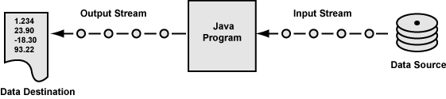
IO Streams
The connection between a program and a data source or destination is called a stream
An input stream handles data flowing into a program
An output stream handles data flowing out of a program

Slide 12

Processing Streams
A processing stream operates on the data supplied by another stream
A buffer is a block of main memory used as a work area
A processing stream is often acts as a buffer
BufferedReader stdin =
new BufferedReader( new InputStreamReader( System.in ) );

Slide 13
Character and Byte Streams
Character streams
  intended exclusively for character data
  Optimized for character data performs useful character-oriented tasks
  Transforms data from/to 16 bit Java char to format used externally
  Source or destination is often a text file
Byte streams
  intended for general purpose input and output
  Data may be primitive data types or raw bytes
  Example of source and destination is a bytecode file created by the Java compiler

Slide 14
Types of Streams
A stream object may be
  An input stream or an output stream
  A processing stream or an ordinary stream
  A character-oriented stream or a byte-oriented stream
  May be connected to a variety of sources or destinations

Slide 15
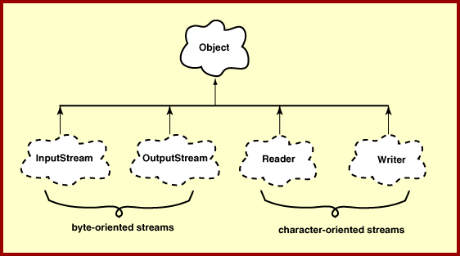
IO Class Hierarchy

Slide 16
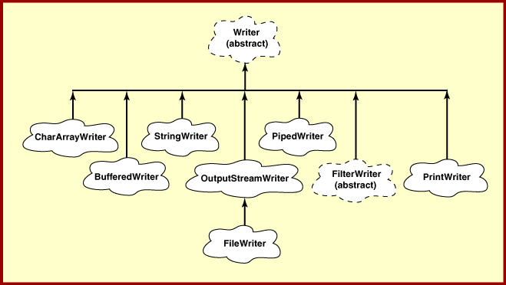
Writer
Receive 16-bit char data from a program and send it to another destination which may use a different character format

Slide 17
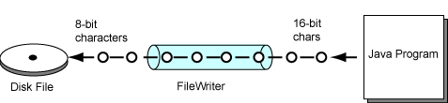
FileWriter
Used for output of character data to a disk file
Translate between the internal Java format (two bytes per character) to external, disk file format (one byte per character)

Slide 18
Example Program
import java.io.*;
class WriteTextFile2 {
public static void main ( String[] args ) {
String fileName = "reaper.txt";
try { // append characters to the file
FileWriter writer = new FileWriter( fileName, true ); writer.write( "Alone she cuts and binds the grain,\n" ); writer.write( "And sings a melancholy strain;\n" ); writer.write( "O listen! for the Vale profound\n" ); writer.write( "Is overflowing with the sound.\n\n" ); writer.close();
} catch ( IOException iox ) {
System.out.println("Problem writing " + fileName );
}
}
}
FileWriter Constructor pass the name of the file. File is created if does not exist, otherwise, it will be replaced if the second parameter is false.
The close() method should always be used when a program is done with a file

Slide 19
BufferedWriter Stream
Disk input and output is more efficient when a buffer is used
Programs that do extensive IO should use buffers
BufferedWriter out =
new BufferedWriter(new FileWriter("stuff.txt"));
out.write(“Hello World”);
out.newLine();
out.close();

Slide 20
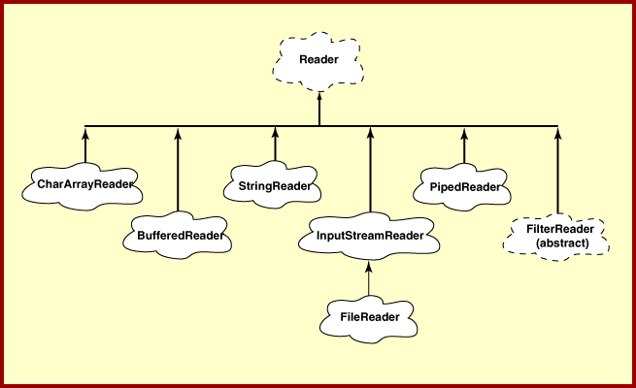
Reader
Deliver 16-bit char data to a program

Slide 21
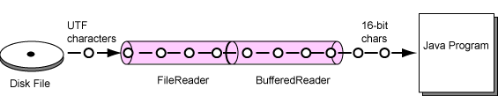
FileReader and BufferedReader
FileReader is used for input of character data from a disk file. It translates characters from disk file format into internal char format
BufferedReader is used to improve efficiency

Slide 22
Example Program
import java.io.*;
class ReadTextFile {
public static void main ( String[] args ) {
String fileName = "reaper.txt";
String line;
try {
BufferedReader in = new BufferedReader(
new FileReader( fileName ) );
line = in.readLine();
while ( line != null ) // continue until end of file { System.out.println( line );
line = in.readLine();
} in.close();
} catch ( IOException iox ) {
System.out.println("Problem reading " + fileName);
} } }

Slide 23
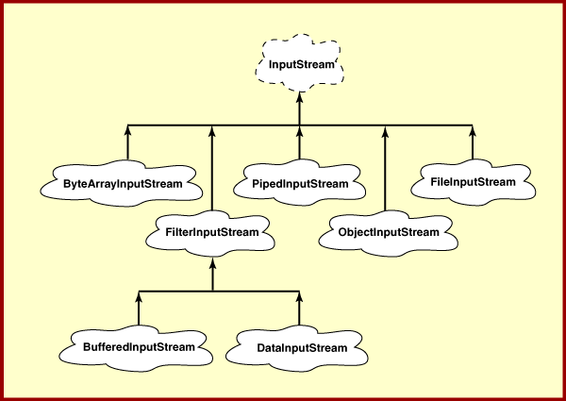
InputStream
Deliver data in groups of 8-bit bytes which can be grouped into the size necessary for the type of data

Slide 24
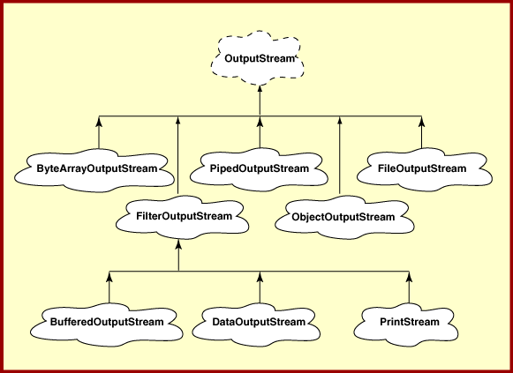
OutputStream
Write groups of 8-bit byte to output destinations

Slide 25
How is an Error Different?
An error is also a problem that occurs when a program is running
An error is represented by an object of class Error
However an error is too severe for a program to handle. The program must stop running

